Slide 1
WELCOME
NAME:LOGESH.R
SUBMITTED DATE:12/12/2024
TITLE:STUDENT PERFORMANCE ANALYSIS

Slide 2
AIM: Identify patterns, trends, and relationships within the dataset.​ Summarize the data in a visually interpretable format.​ Enhance understanding of the underlying data structure.​ Support informed decision-making based on data-driven insights.​

Slide 3
PROBLEM STATEMENT: Data Quality: Real-time datasets often contain missing values, duplicates, and inconsistent formats, reducing the reliability of analyses.​ Scalability: As data volumes grow rapidly, the systems managing the data struggle to scale efficiently.​ Timeliness: Cleaning and preparing the data for analysis is time-consuming, which hinders real-time decision-making ​

Slide 4
Objective
The project aims to develop an automated, scalable, and efficient system to process, clean, and analyze messy real-time datasets. By addressing these challenges can leverage the full potential of real-time data to make timely and accurate decisions, optimize operations, and enhance people experiences.​ Data Cleaning ​ Real-Time Processing​ ​

Slide 5
Technologies and Methodologies :​
Data Cleaning Tools: Python-based libraries (e.g., Pandas DataFrames, numpy ) and custom scripts for automated data quality management.​
Machine Learning: a role in the development and evaluation of machine learning algorithms, primarily in the context of statistical analysis and hypothesis testing. ​
Visualization: Seaborn ,Matplotlib and plotly tools of python are used for visualizations

Slide 6
Functionalities​
Real-Time Data Ingestion​
Searching dataset in many web pages and choosing the dataset.​
Automated Data Cleaning​
Identify and resolve data quality issues like missing values, duplicates, and outliers to maintain data accuracy and reliability.​
Scalable Data Processing​
Utilize distributed computing frameworks to handle large volumes of data efficiently while ensuring minimal latency.​

Slide 7
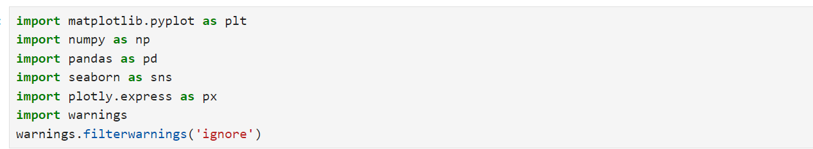
IMPORTING THE MODULES:

Slide 8
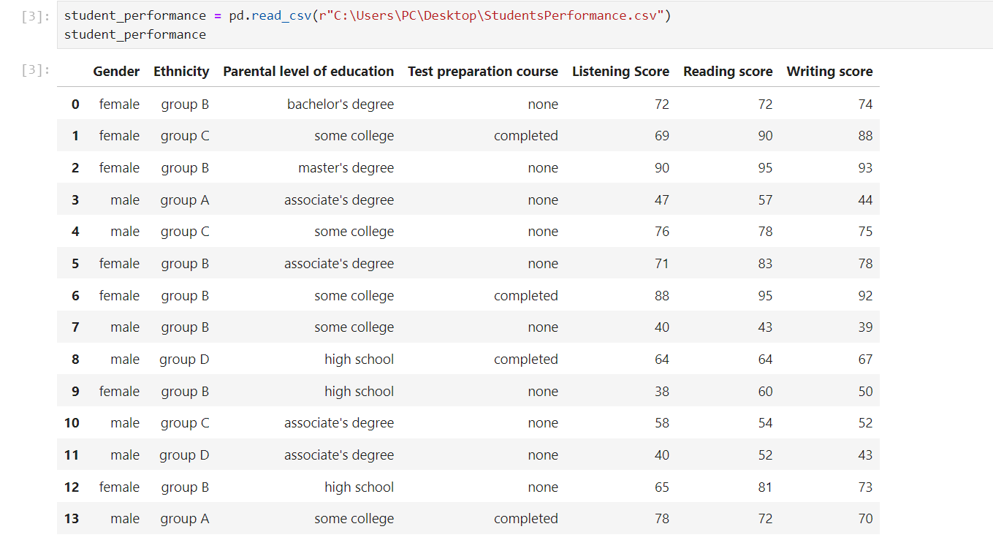
CREATING THE DATA FRAMES:

Slide 9
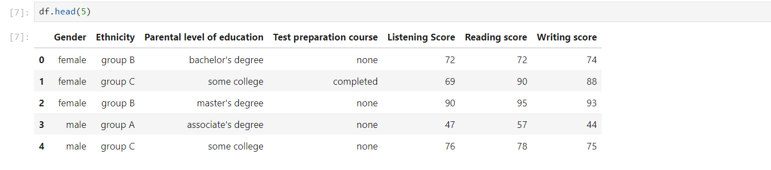
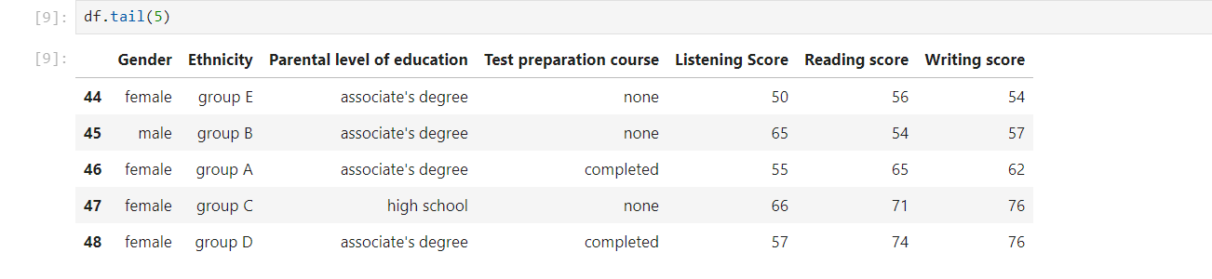
EXTRACTING THE DATASET:
ABOVE FIVE ROWS:
LAST FIVE ROWS:

Slide 10
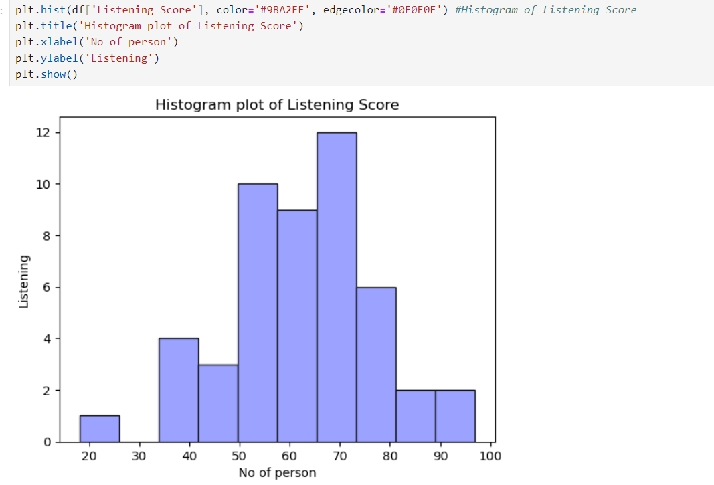
HISTOGRAM FOR LISTENING SCORE:

Slide 11
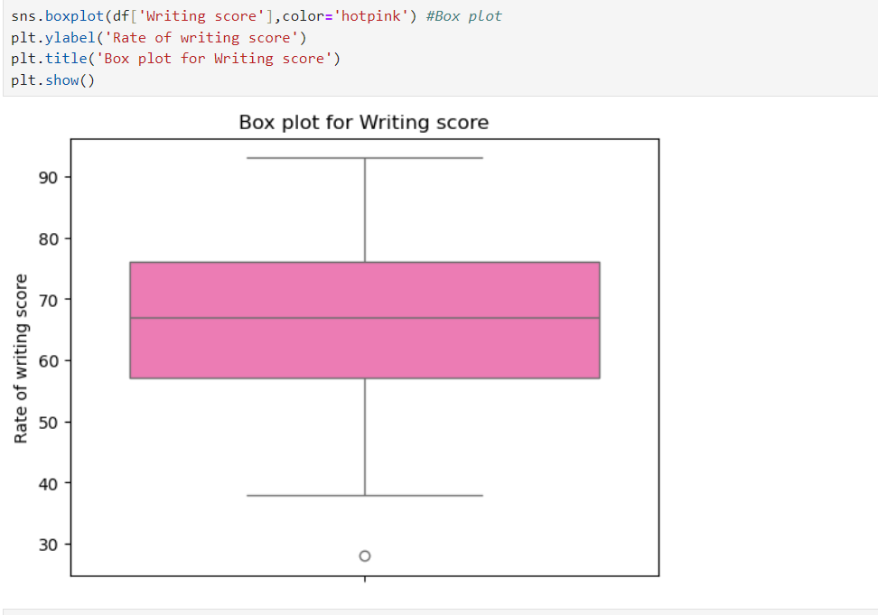
BOX PLOT IN WRITING SCORE:

Slide 12
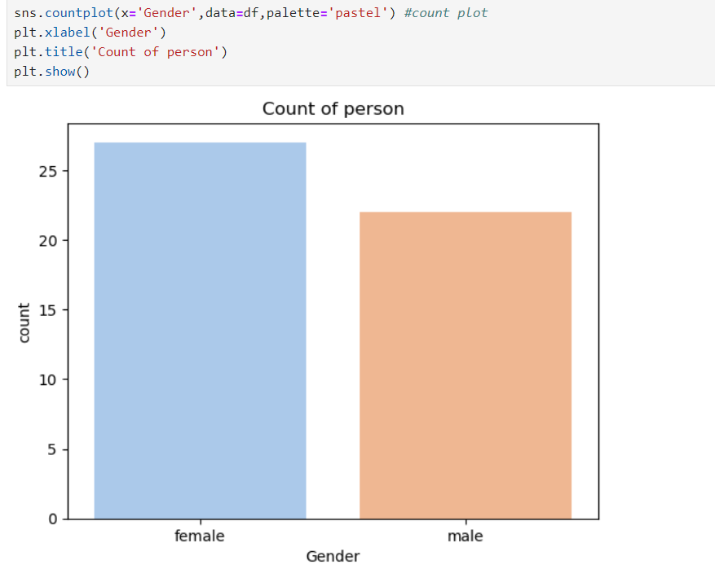
COUNT PLOT:

Slide 13
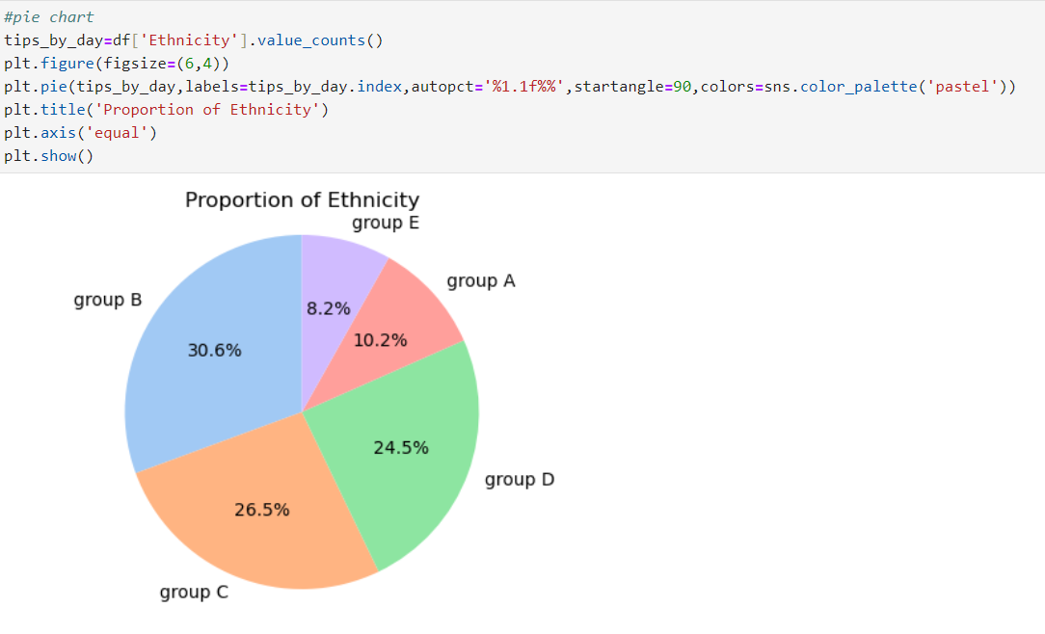
PIE CHART FOR ETHNICITY:

Slide 14
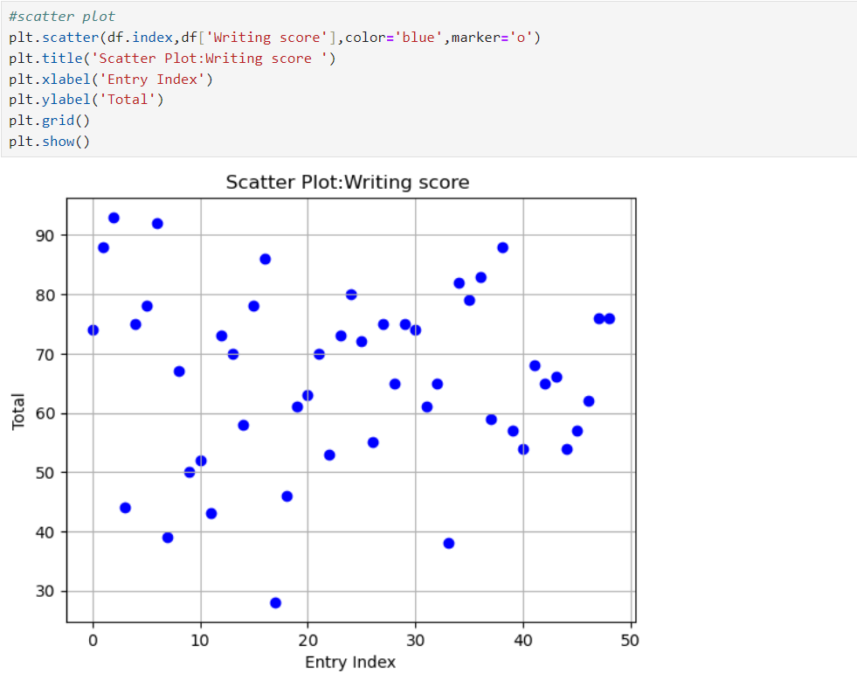
SCATTER PLOT:

Slide 15
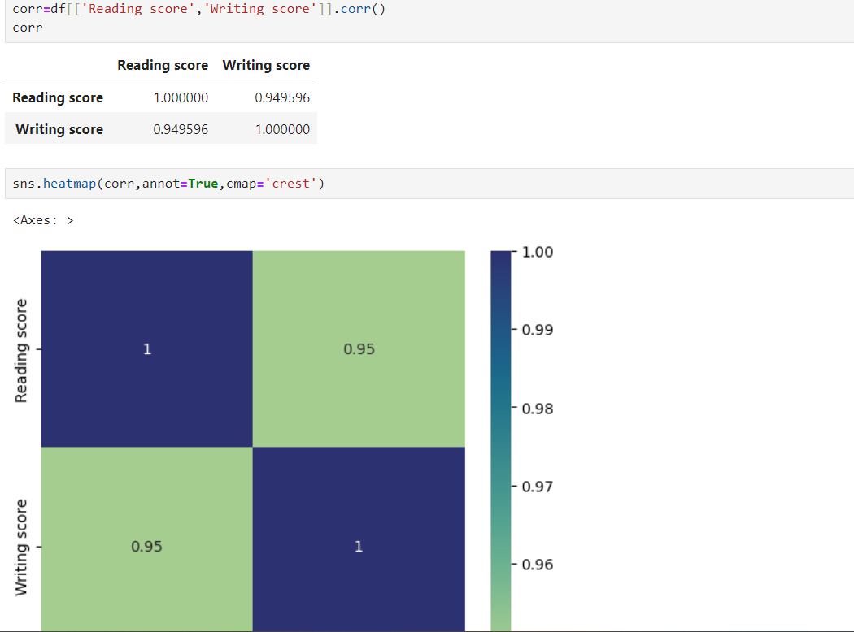
HEATMAP FOR READING AND WRITING SCORE:

Slide 16
THANK YOU

